Slide 1
Mountain meteorology research using the TODWL
D. Emmitt (SWA)
S. de Welkker (UVA) and K. Godwin (KG,LLC)
16 -18 October 2012
WG meeting in Boulder, CO

Slide 2
CIRPAS Twin Otter at MATERHORN
ARO (Videen) funding ferry flights from Monterey and 10 hours on site.
Support MATERHORN IOPs
Provide 3D context for complex terrain flow
ONR(Ferek) allowing 10 -15 UPP flight hours to be used at GMAST.
Pursue UPP objectives with evaluation of EDMF parameterization over land in the presence of organized structures; nocturnal flows

Slide 3
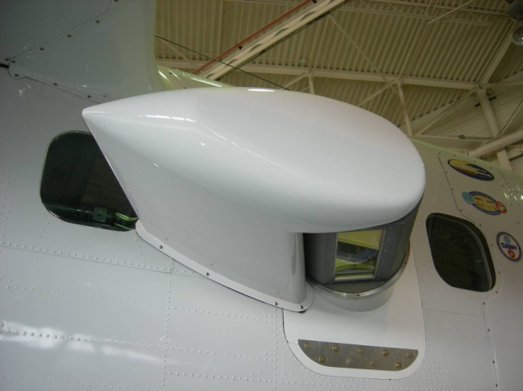
TODWL

Slide 4
CIRPAS Twin Otter
Aerosols (probes)
Fluxes
Surface temperature
Wind profiles
Aerosol profiles

Slide 5
Flight profile
Aircraft is based out of U42 (current plan)
~ 30 minute to Granite Mountain
climb to 12K feet (~5K feet above peaks)
Twin Otter in Utah between 5 October and 18 October
Missions last~ 4 hours
7 missions
12 hour rules for pilots apply
12 hours on call
12 hours between “on calls”.

Slide 6
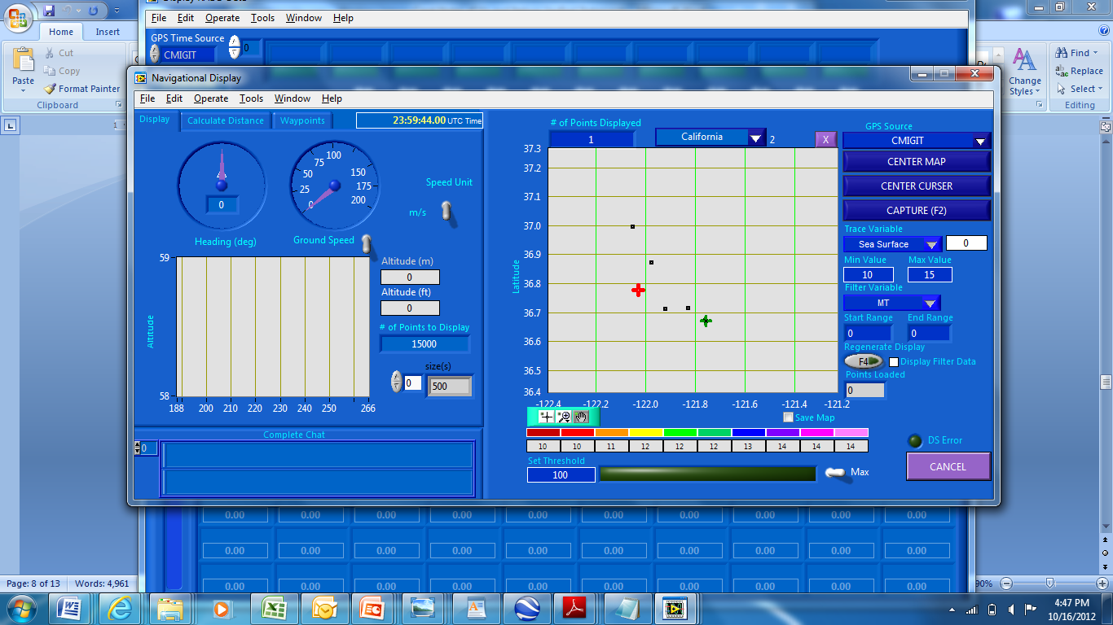
RADD for Twin Otter

Slide 7
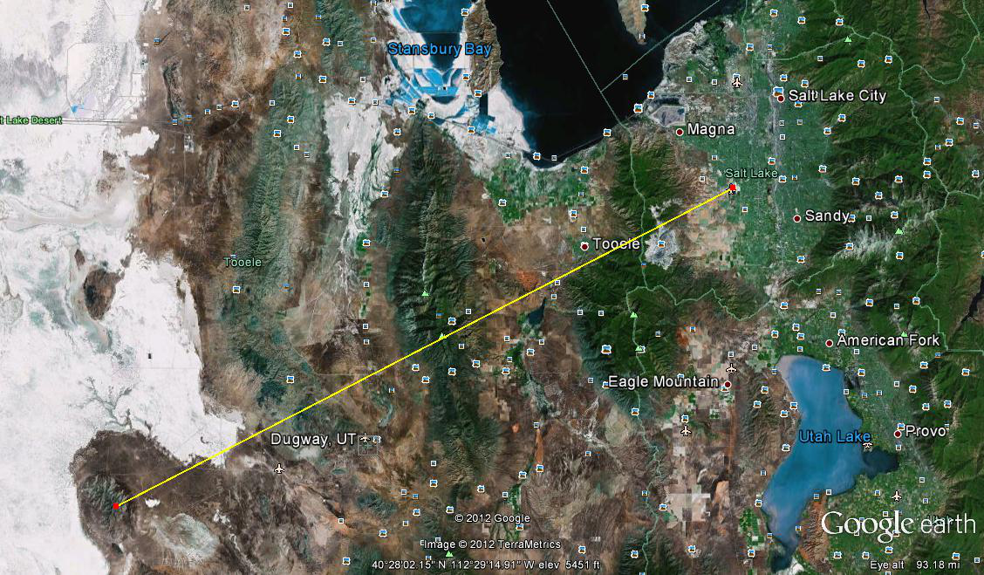

Slide 8
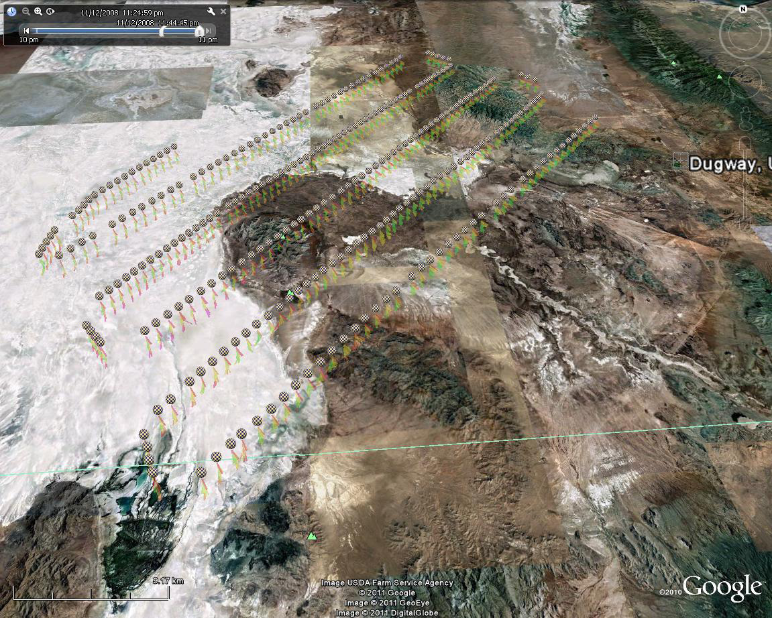

Slide 9
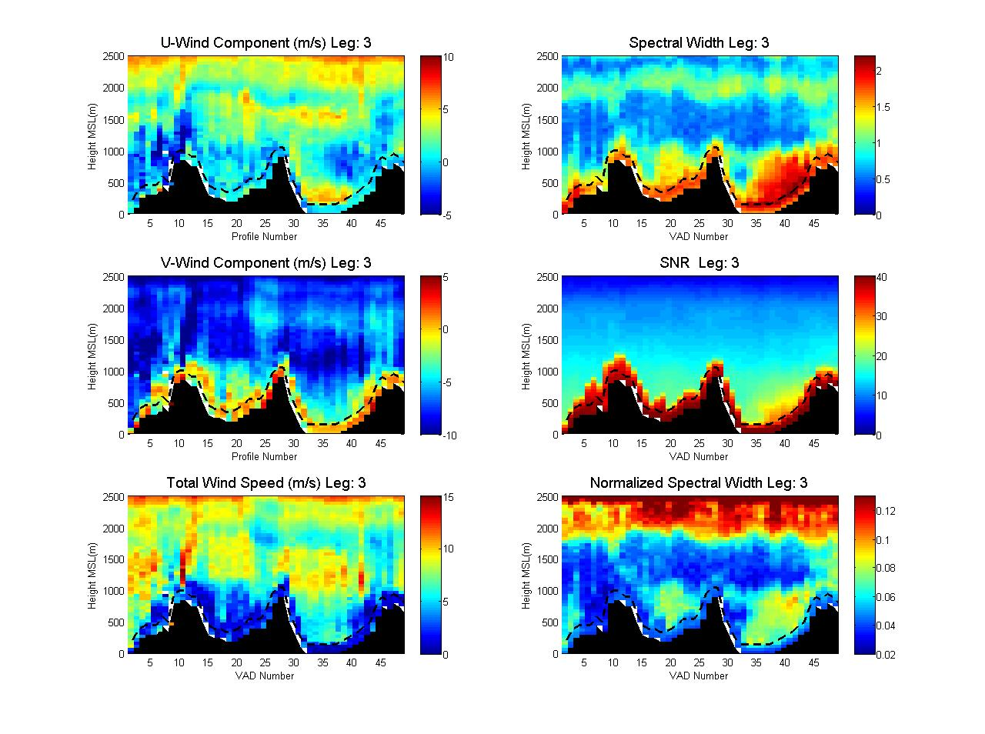
From DeWekker, et.al 2012

Slide 10
Easterly Leg 3
Easterly Leg 2
Easterly Leg 1

Slide 11
TODWL data products
Downward conical scans (12 point step stare)
Off-nadir angle of 20 degrees
20 -25 seconds for full 360 scan ( ~ 1 -1.2km)
U,V,W with 50 m vertical resolution
Sigma (U,V) ~ .10 m/s ; Sigma (W) ~ ??
SNR (aerosols)
Nadir samples
5 seconds between conical scans
50 m vertical resolution with sigma(w) ~ .10m/s`
Structure prospecting
Straight ahead and down 3 -6 degrees

Slide 12
Data to date
4 hours of nadir profiles between Monterey and SLC from 12 -14k feet.
Excellent triple pass over Ruby Mt with 50m/s winds aloft and significant lee waves. Great case study for validating WRF model. Rawinsonde support from Elko.
5 flights over Granite Mountain with several hours flown at differing heights in the BL to measure fluxes with TODWL providing the context.

Slide 13
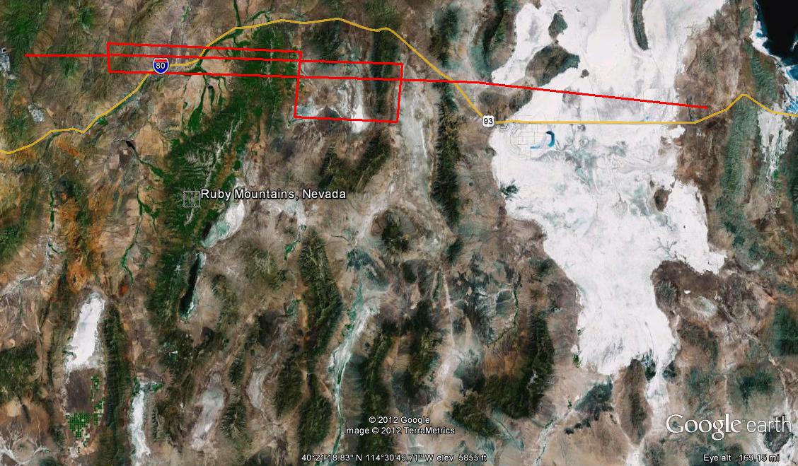
Ruby Mountains (waves)
Granite Mtn

Slide 14
Summary
Weather patterns provided several different flow patterns over study area (Dugway Proving Grounds)
TODWL performed well
Other data provided by UAVs, tethered balloon, ground-based DWLs, instrumented towers, rawinsondes and smoke releases.
TODWL data will support model (WRF/NCAR and WRF/Pu) validation and development.

